Slide 1
Contemporary Challenges of European Public Media: Disinformation, Digital Platform Monopoly and Public Practice
21st Taiwan European Culture Forum
Adrian Rauchfleisch
Deputy director-general (EU Centre in Taiwan)
Associate Professor (Graduate Institute of Journalism)
Twitter: @OuZhouAdi
Notes:
Department of Foreign Languages, National Taiwan University, Department of Foreign Languages, Department of Foreign Languages, Tsinghua University

Slide 3
News consumers in Asia and Europe…

Slide 4
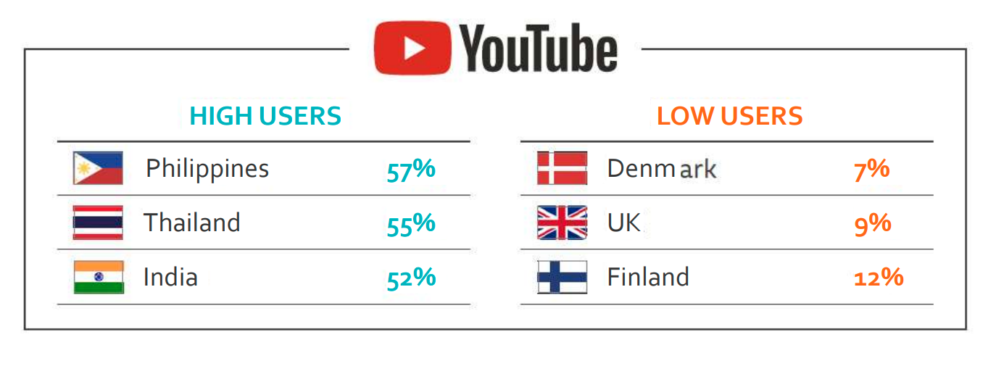
Which, if any, of the following have you used for news in the last week?
Notes:
Q12B. Which, if any, of the following have you used for news in the last week? Base: Total sample in each market (n ≈ 2000).

Slide 5
Germany
Taiwan

Slide 6
Trust in media

Slide 7
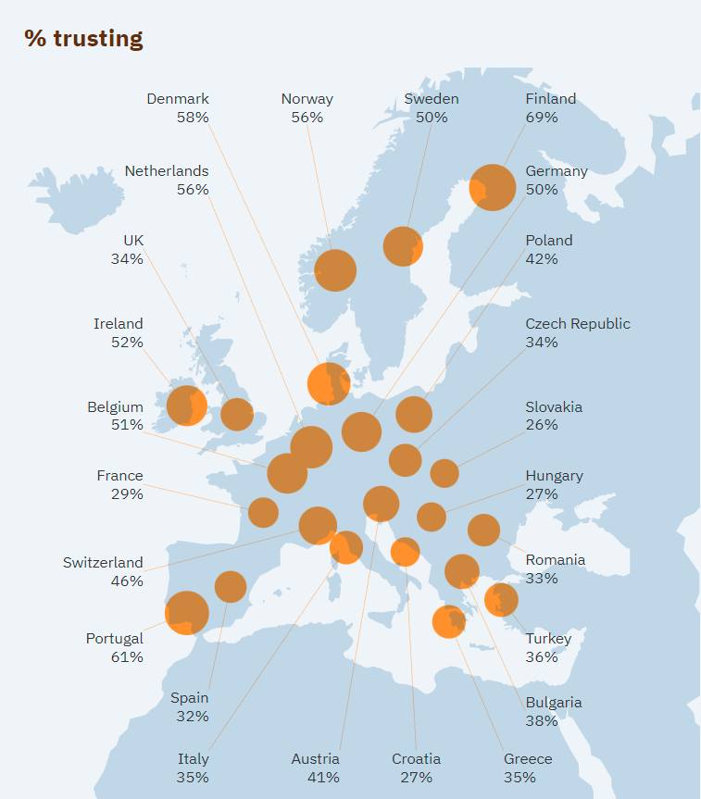
Different media systems
Different levels of trust
https://reutersinstitute.politics.ox.ac.uk/digital-news-report/2022/interactive
Notes:
Democratic corporatist
Liberal
Polarized pluralistic

Slide 8
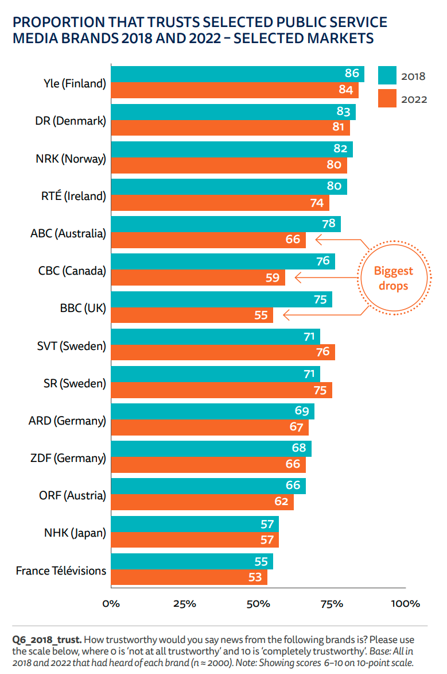
Trust in public service media

Slide 9
Trust in public service media

Slide 10
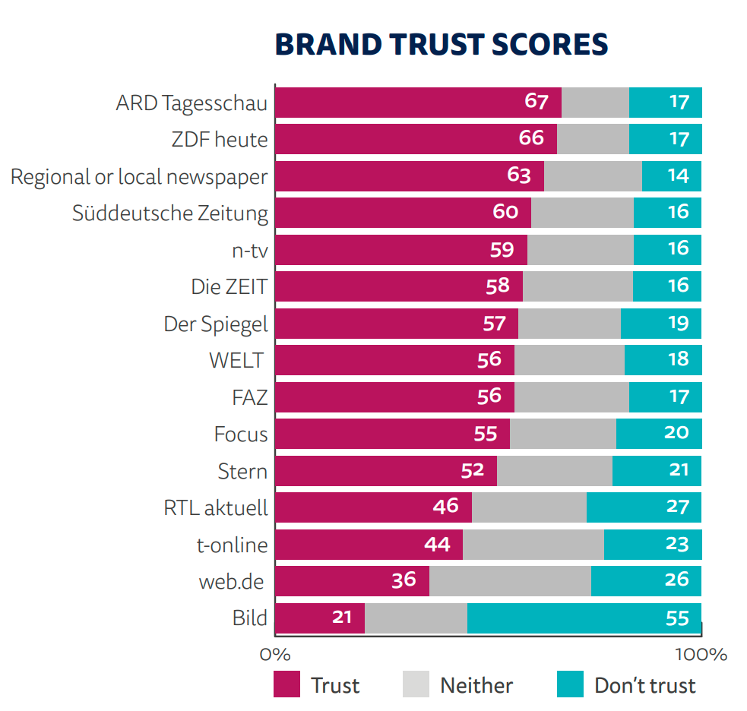
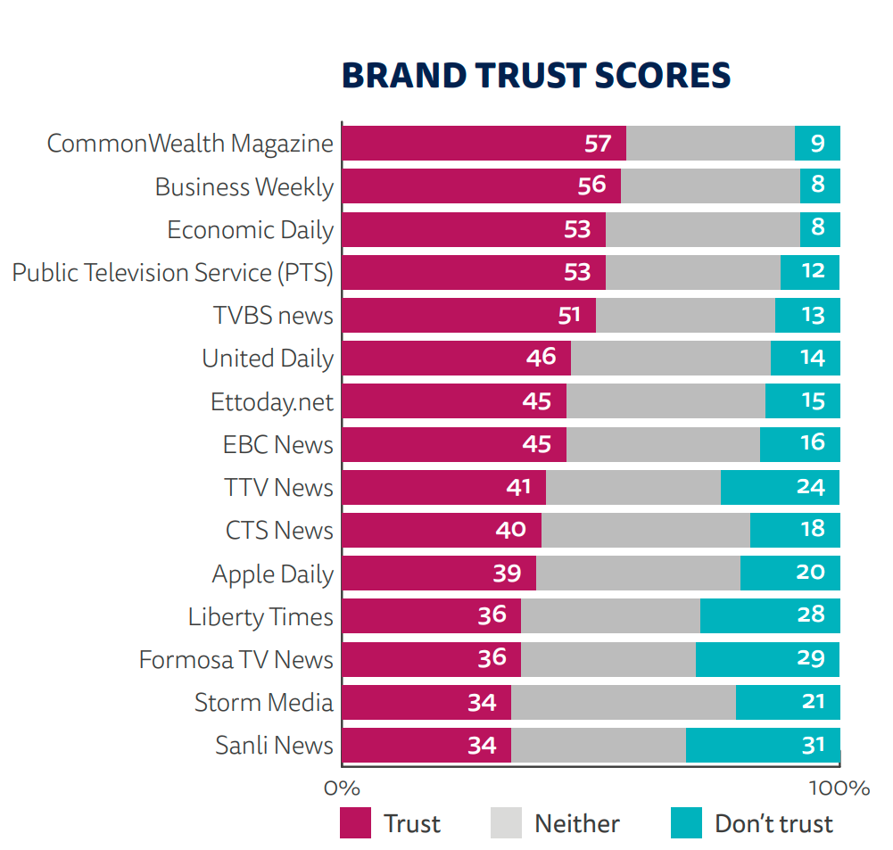
Germany
Taiwan

Slide 11
Germany
Taiwan

Slide 12
Germany
Taiwan

Slide 13
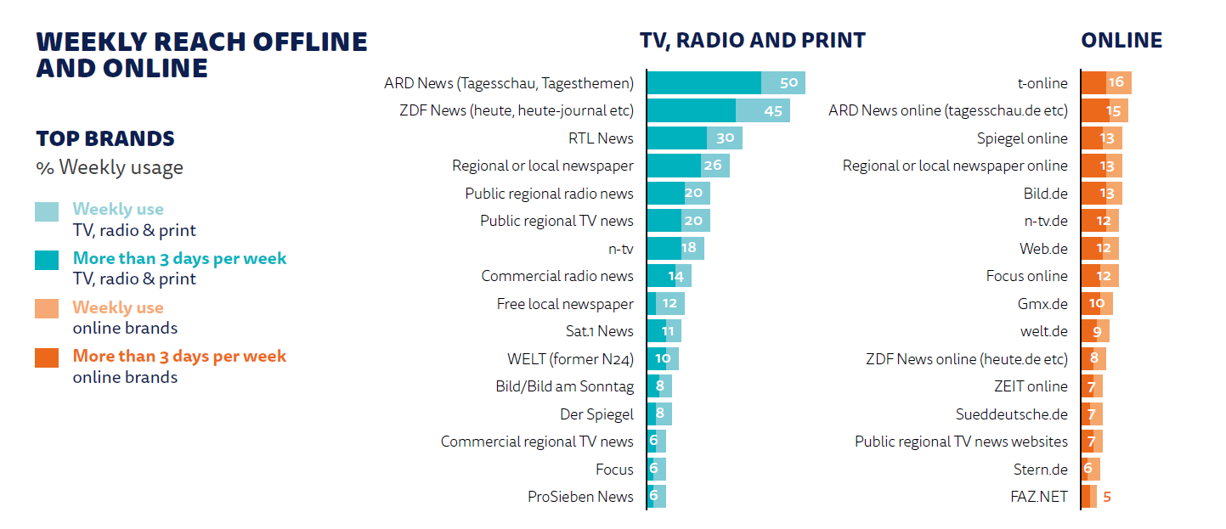

Slide 14
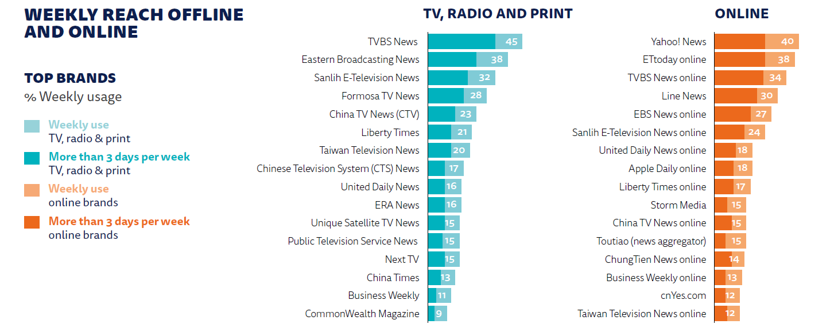

Slide 15
Contemporary Challenges of European Public Media: Disinformation, Digital Platform Monopoly and Public Practice
21st Taiwan European Culture Forum
Adrian Rauchfleisch
Deputy director-general (EU Centre in Taiwan)
Associate Professor (Graduate Institute of Journalism)
Twitter: @OuZhouAdi
Notes:
Department of Foreign Languages, National Taiwan University, Department of Foreign Languages, Department of Foreign Languages, Tsinghua University

